Slide 1
Balanced Scorecard Approach To Strategic Planning
The following graphics shown individually, and then summarized, depict how the CEO and his/her management team sequentially:
  Lay out a clear vision of how they can create additional value for their customers in ways that streamline internal operations and improve financial performance too
  Specify measurable performance improvement targets that strengthen market positioning and the bottom line by enhancing clinical quality, efficiency and revenue producing capabilities
  Balance the timing of investments and operating cash flow to support the vision’s realization by assuring timely access to capital.
One CEO noted recently that taking this balanced approach to financially oriented strategic planning at the right time had helped avoid the need at a later date for the Hunter Group style of slash and burn planning.

Slide 2
The Hospital’s Vision And Strategic Direction Are Supported By Its Targets For Rebalancing Financial Performance
MARKETS
PHYSICIANS
1. Grow subspecialty referral volume from the Core and Secondary markets
2. Strengthen CGH’s primary care presence in Dublin to better serve the elderly and recent arrivals
3. Target selected physicians and hospitals in the secondary market for subspecialty referrals/admissions
4. Develop an effective marketing communication strategy for targeted consumers, buyers and physicians
1. Support private primary care physicians in their efforts to serve targeted communities
2. Strengthen relationships with aligned PCPs and support affiliated subspecialists in serving the patients of those network PCPs
3. Compensate faculty only for their academic activities and expect them to produce sufficient practice income to round out equitable compensation packages
1. Reconfigure service capacity to improve service mix and profitability and serve more patients at the Main Site
2. Differentiate CGH and its physicians from competitors on high quality clinical outcomes and emerging medical technology
3. Promote selected Product Lines and physicians as high tech, high quality subspecialty healthcare providers
VISION
Become recognized
as a high quality tertiary referral center which also serves the continuum of healthcare needs of the community
SERVICES
1. Focus primarily on the needs and preferences of consumers in the Core Market
2. Focus in Dublin on the subspecialty referral needs and preferences of selected PCPs and community hospital-affiliated specialists
3. Focus on the habilitation needs of providers in the Core Market and their clients to replace volume reductions in other areas
CUSTOMERS
1. Increase HMO/PPO rates to parity with other teaching hospitals in the system and secure more case rates
2. Improve productivity and quality through the use of more effective clinical, IT and management systems
3. Increase billing and collection for all services, high cost implantables and consumable supplies
4. Assure ongoing access to capital at favorable costs
1. Attract sufficient numbers of competent clinical employees by improving working conditions, offering competitive compensation and providing such benefits as day care and evening care for their children
2. Improve employee retention and productivity
FINANCE
EMPLOYEES

Slide 3
Twenty Eight Targets For Performance Improvements And Conceptual Facilities Reconfiguration Plans Are Expected To Produce Financial Stability
15 Planned Improvements In
Market Positioning And Financial Performance
13 Planned Improvements In Quality, Efficiency And Revenue Production
SERVICE VOLUME
UNIT NET REVENUE
UNIT COST
CLINICAL QUALITY AND EFFICIENCY
ANTICIPATED NORTH SITE FACILITIES RECONFIGURATIONS
1. Redesign Geriatrics Program to gain Medicare discharges from Core Market
2. Add PCPs in Secondary Market and woo split-admitters to add discharges
3. Brand CGH and selected high margin product lines to increase their volumes
4. Win cardiac surgery discharges from a mutually acceptable contract with Aetna
5. Add cardiac surgeries and proportionate PTCAs from Secondary Market
6. Increase the admission yield of the Secondary Market clinics
7. Increase speech and hearing volume through diversification initiatives
8. Increase volume to meet targets set for all other services
1. Renegotiate selected HMO contracts at appropriate times to:
  Increase rates for selected services such as obstetrics
  Establish break-even case rates for complex DRGs
  Provide high cost thresh holds to start per diems for tracheostomy and other cases
  Bill separately for implantables, etc.
  Agree to limit denied days to those concurrently identified
2. Periodically consider whether individual HMO contracts represent CGH’s best use of scarce beds
3. Establish Sub Acute Transitional Care Unit if/when state regulation is adopted
1. Achieve performance improvement targets and initiatives as part of business plans for:
  Rehab medicine
  Women’s services
  Newborn services
  Children’s services
2. Establish plan for productivity-based Faculty compensation
3. Reduce Administrative Expenses to benchmark for peer hospitals
4. Reduce staffing and other patient care and ancillary costs to benchmark values
1. Set standards for clinical quality and efficiency, develop infrastructure and monitor for compliance
2. Reduce Medicare LOS to free up beds at Main Site, including quicker imaging turnaround times
3. Reduce number of blocked beds at Main Site
4. Consider resizing bed capacity of selected services:
  Rehab Medicine
  Women & Children
  Drug Detox
  Alcohol Rehab
5. Perfect and utilize methods for promotion and marketing communication with:
  Patients
  Seniors
  Physicians
  Employers
1. Move ICU & CCU to New Tower at the Main Site
2. Create Short Stay Unit in old CCU/ICU space in existing Main Site hospital
3. Build 30 new rehab beds and also move 30 rehab beds from existing location, to space contiguous with new beds
4. Renovate to gain 30 additional med/surg beds and replace 17 Gyn beds
5. Replace Emergency Department for expansion of services and shell second & third floors of new ED building
6. Move NICU and OB-LDR to second and third floors of new ED building
7. Build Education Center
8. Have physicians build new Medical Office Building

Slide 4
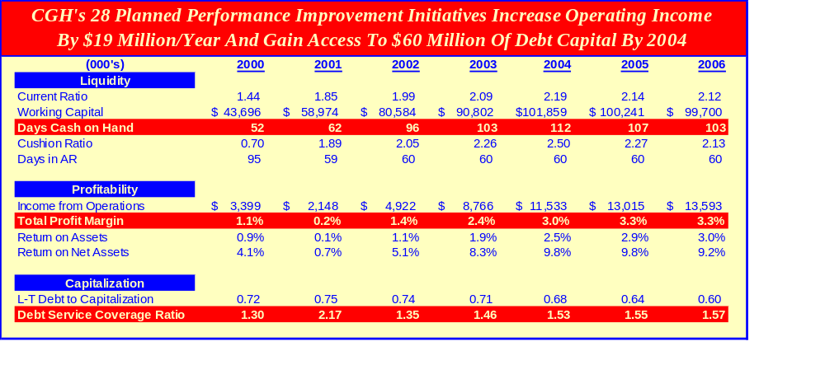
Implementation Of The Performance Improvement Initiatives Will Assure Access To Sufficient Capital To Realize The Hospital’s Vision

Slide 5
15 Planned Improvements In
Market Positioning And Financial Performance
13 Planned Improvements In Quality, Efficiency And Revenue Production
SERVICE VOLUME
UNIT NET REVENUE
UNIT COST
CLINICAL QUALITY AND EFFICIENCY
ANTICIPATED NORTH SITE FACILITIES RECONFIGURATIONS
1. Redesign Geriatrics Program to gain Medicare discharges from Core Market
2.Add PCPs in Secondary Market and woo split-admitters to add discharges
3.Brand CGH and selected high margin product lines to increase their volumes
4.Win cardiac surgery discharges from a mutually acceptable contract with Aetna
5.Add cardiac surgeries and proportionate PTCAs from Secondary Market
6.Increase the admission yield of the Secondary Market clinics
7.Increase speech and hearing volume through diversification initiatives
8.Increase volume to meet targets set for all other services
1.Renegotiate selected HMO contracts at appropriate times to:
  Increase rates for selected services such as obstetrics
  Establish break-even case rates for complex DRGs
  Provide high cost thresh holds to start per diems for tracheostomy and other cases
  Bill separately for implantables, etc.
  Agree to limit denied days to those concurrently identified
2.Periodically consider whether individual HMO contracts represent CGH’s best use of scarce beds
3.Establish Sub Acute Transitional Care Unit if/when state regulation is adopted
1.Achieve performance improvement targets and initiatives as part of business plans for:
  Rehab medicine
  Women’s services
  Newborn services
  Children’s services
2. Establish plan for productivity-based Faculty compensation
3.Reduce Administrative Expenses to benchmark for peer hospitals
4.Reduce staffing and other patient care and ancillary costs to benchmark values
1.Set standards for clinical quality and efficiency, develop infrastructure and monitor for compliance
2.Reduce Medicare LOS to free up beds at Main Site, including quicker imaging turnaround times
3. Reduce number of blocked beds at Main Site
4.Consider resizing bed capacity of selected services:
  Rehab Medicine
  Women & Children
  Drug Detox
  Alcohol Rehab
5.Perfect and utilize methods for promotion and marketing communication with:
  Patients
  Seniors
  Physicians
  Employers
1.Move ICU & CCU to New Tower at the Main Site
2.Create Short Stay Unit in old CCU/ICU space in existing Main Site hospital
3.Build 30 new rehab beds and also move 30 rehab beds from existing location, to space contiguous with new beds
4.Renovate to gain 30 additional med/surg beds and replace 17 Gyn beds
5.Replace Emergency Department for expansion of services and shell second & third floors of new ED building
6.Move NICU and OB-LDR to second and third floors of new ED building
7.Build Education Center
8.Have physicians build new Medical Office Building
CGH’s Vision And Strategic Direction Are Supported By Its Targets For Rebalancing Financial Performance
MARKETS
1. Grow subspecialty referral volume from the Core and Secondary markets
2. Strengthen CGH’s primary care presence in Dublin to better serve the elderly and recent arrivals
3. Target selected physicians and hospitals in the secondary market for subspecialty referrals/admissions
4. Develop an effective marketing communication strategy for targeted consumers, buyers and physicians
1. Support private primary care physicians in their efforts to serve targeted communities
2. Strengthen relationships with aligned PCPs and support affiliated subspecialists in serving the patients of those network PCPs
3. Compensate faculty only for their academic activities and expect them to produce sufficient practice income to round out equitable compensation packages
PHYSICIANS
1. Reconfigure service capacity to improve service mix and profitability and serve more patients at the Main Site
2. Differentiate CGH and its physicians from competitors on high quality clinical outcomes and emerging medical technology
3. Promote selected Product Lines and physicians as high tech, high quality subspecialty healthcare providers
1. Focus primarily on the needs and preferences of consumers in the Core Market
2. Focus in Dublin on the subspecialty referral needs and preferences of selected PCPs and community hospital-affiliated specialists
3. Focus on the habilitation needs of providers in the Core Market and their clients to replace volume reductions in other areas
SERVICES
VISION
Become recognized
as a high quality tertiary referral center which also serves the continuum of healthcare needs of the community
CUSTOMERS
1. Increase HMO/PPO rates to parity with other teaching hospitals in the system and secure more case rates
2. Improve productivity and quality through the use of more effective clinical, IT and management systems
3. Increase billing and collection for all services, high cost implantables and consumable supplies
4. Assure ongoing access to capital at favorable costs
1. Attract sufficient numbers of competent clinical employees by improving working conditions, offering competitive compensation and providing such benefits as day care and evening care for their children
2. Improve employee retention and productivity
FINANCE
EMPLOYEES

